Slide 1






VISUALIZING THE JOVIAN SYSTEM LIKE NEVER BEFORE
Exploring the Giants of the Solar System
Motto: “If you need space, go to space!”
Aditya Kumar
Shreya Kohli
Manpreet Singh
Pranav Bansal
Priyangshu Sarkar
Team Website: https://github.com/priyangshusarkar77/NASA-SPACE-APPS-CHALLANGE/tree/main
Project Website: https://nisac2022.divineduty.xyz/

Slide 2

01
Introduction
02
Scientific Images
Aesthetic Images
04
Fun Activities
03
AGENDA
05
Advantages

Slide 3

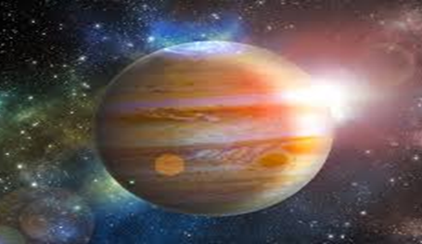
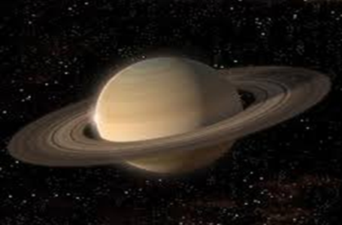
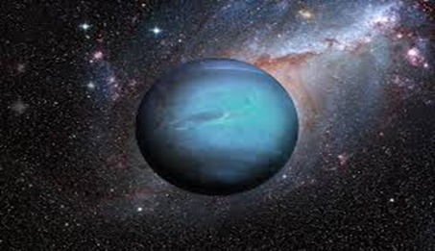
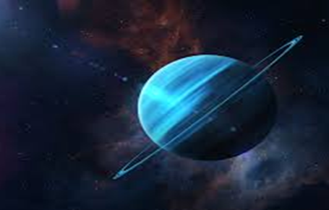
INTRODUCTION
The Jovian Planets:
These images of the four Jovian planets — Jupiter, Saturn, Uranus, and Neptune — hint at some of the remarkable attributes that set them apart from the smaller, rocky terrestrial planets. Also called “giant planets,” the Jovian planets occupy orbits in the outer solar system at distances ranging from 5(Jupiter) to 30(Neptune) times the Earth’s distance from the Sun.
Unlike the terrestrial planets that make up our inner solar system — Mercury, Venus, Earth, and Mars — the Jovian planets do not have solid surfaces. Instead, they are composed primarily of hydrogen and helium, with traces of methane, ammonia, water, and other gases in their atmospheres.

Slide 4
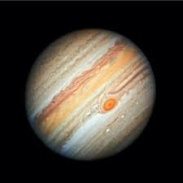
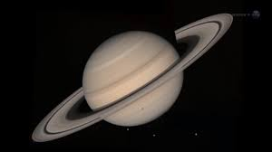
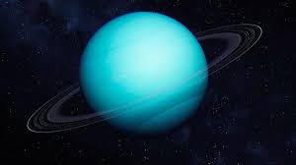
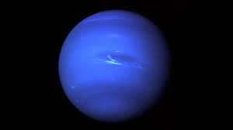
THE JOVIAN PLANETS
Jupiter is the biggest planet in our Solar System
Saturn is composed of hydrogen and helium
Uranus is the only planet whose equator is nearly at a right angle to its orbit
Neptune is not visible to the unaided eye and is the only planet in the Solar System found by mathematical prediction rather than by empirical observation.

Slide 5
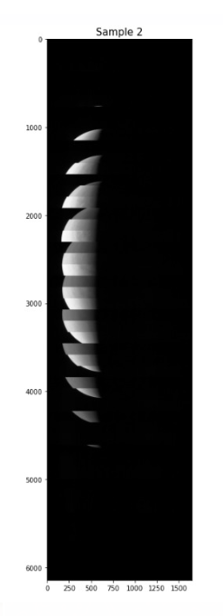
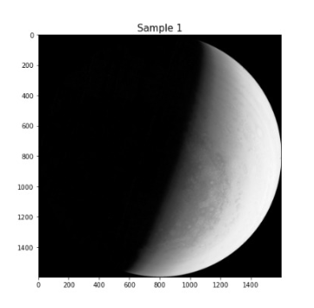
SCIENTIFIC IMAGES
STEP-1
STEP-2
STEP-3
We were able to use different image processing techniques to create a sample dataset for our machine learning model.
We were able to use the segmentation and labeling function to create different parameters that can be used for a simple classifier model.
With this, we can see that image processing techniques can be used as a way to extract different parameters from images.

Slide 6
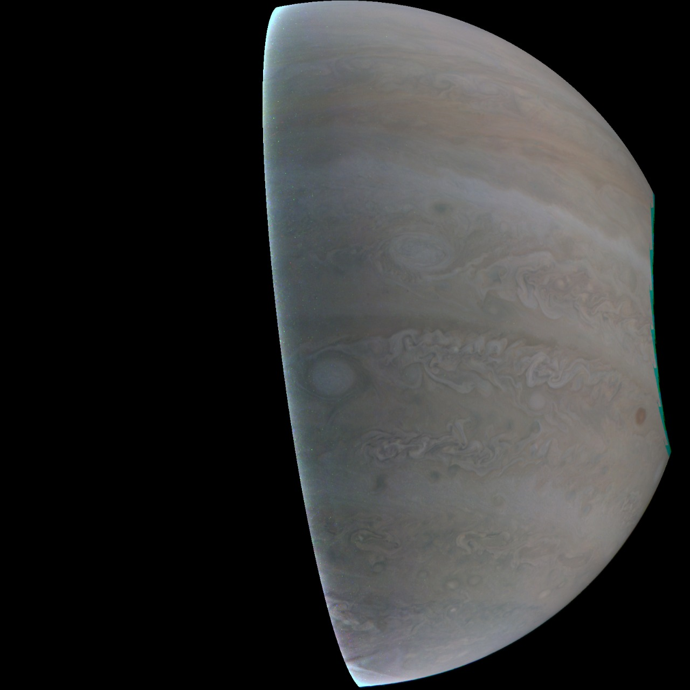
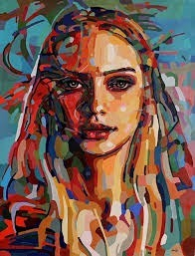
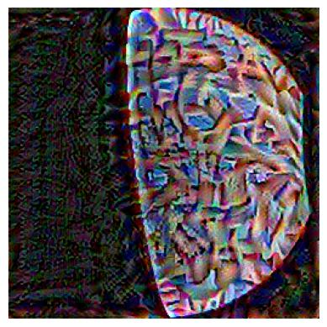
AESTHETIC IMAGES
Created a CNN model
Took a style image
Took a content image
Combined both the images to form an artistic image

Slide 7
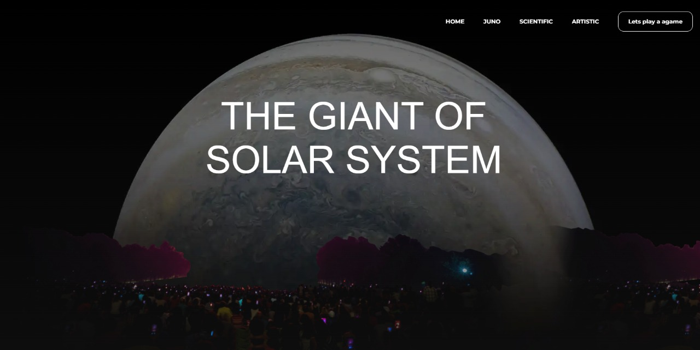
WEBSITE PREVIEW
Our website provides a user-friendly and interesting way to visualize the Jovian System as never before.

